Slide 1
Royal Cars Car management system GitHub Link : https://github.com/mdsajibahamed/car-rental.git Domain link : https://rayal.isdb-pwad.com Features : 1. Car rental 2. Car Painting 3. Car cleaning 4. Car Repairing 5. Car Financing

Slide 2
Home page

Slide 3
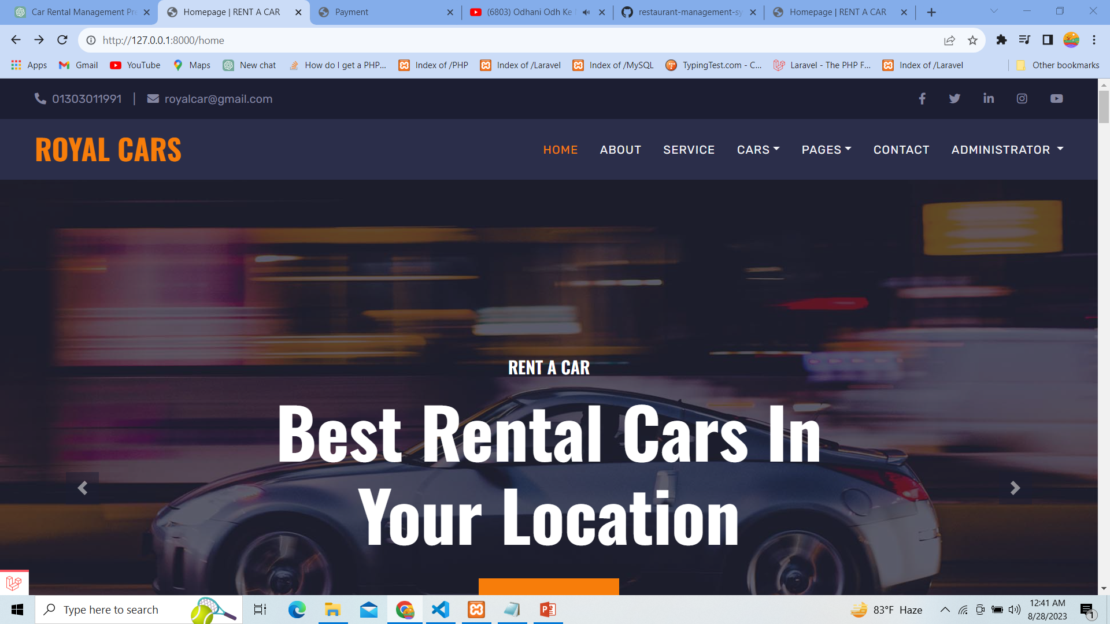

Slide 4
Welcome to Royal Cars 24/7 hours car rental services Rental reservation open anytime Picked and drop lots of location

Slide 5
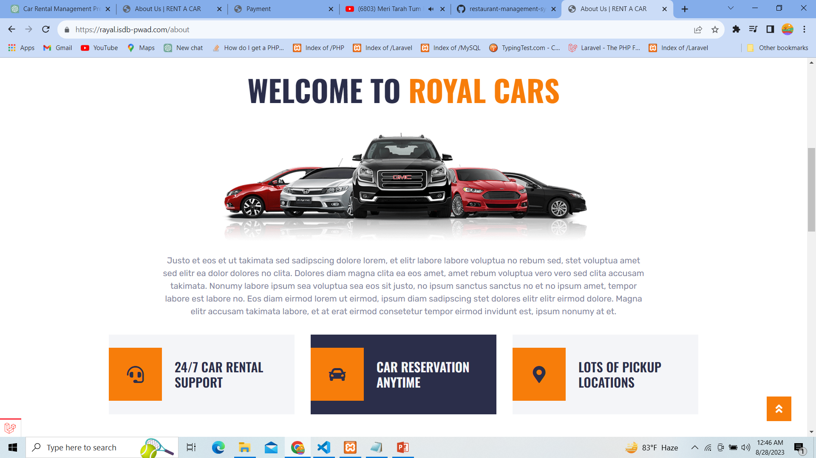

Slide 6
Our Vehicle features: Vehicle information and listing Location-based rentals Customer relationship management Location-based rentals Our Vehicle Services : 1. Car Painting 2. Car cleaning 3. Car Repairing 4. Car Financing 5. Car Rental

Slide 7
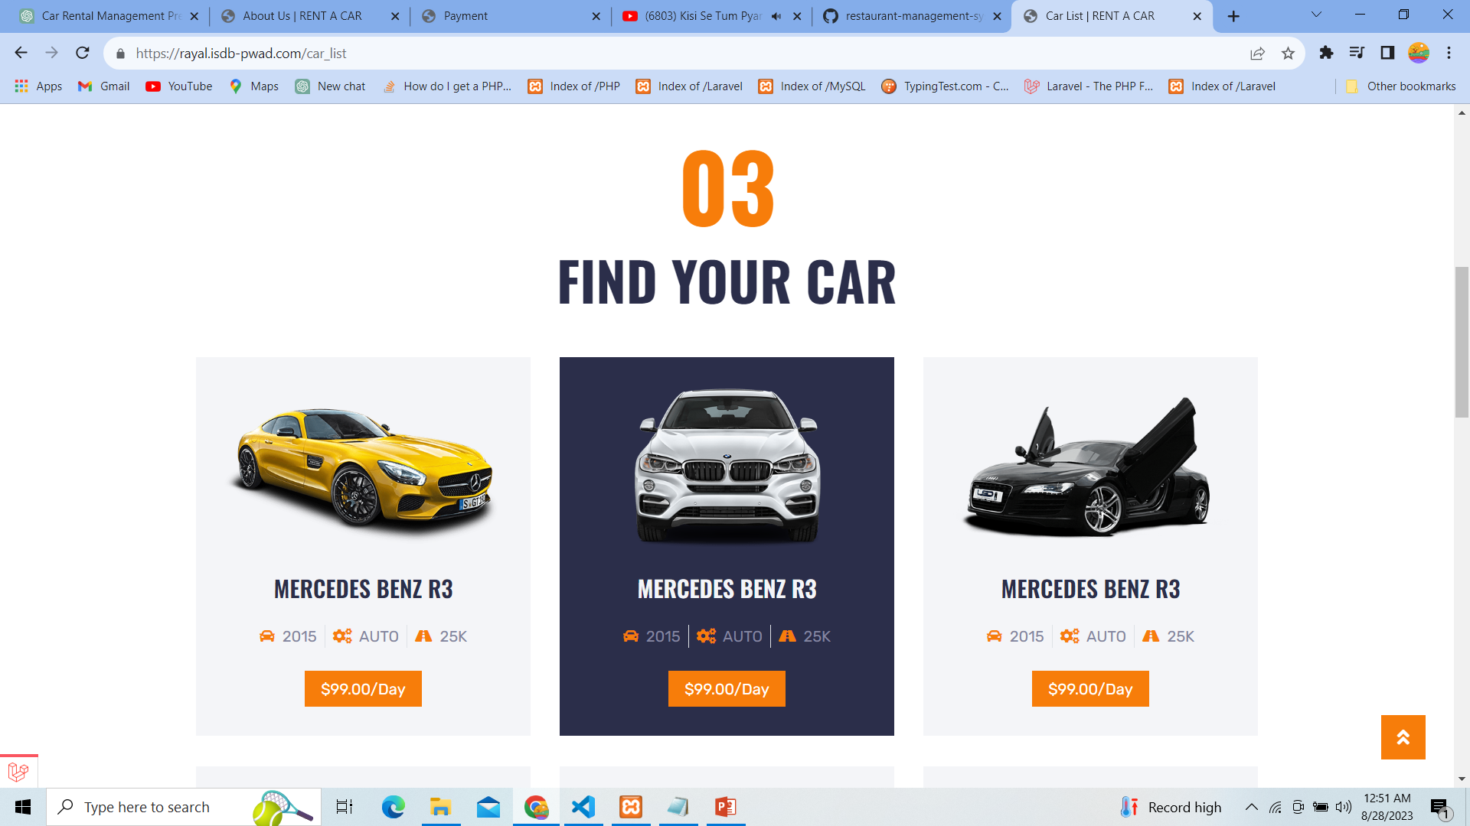

Slide 8
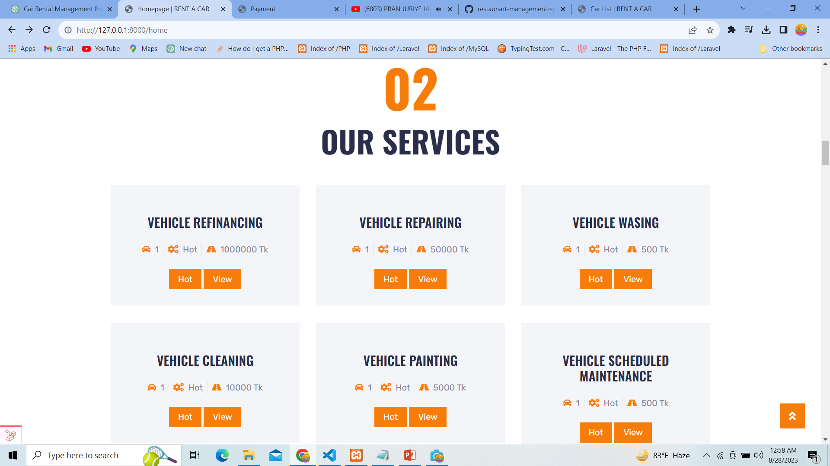

Slide 9
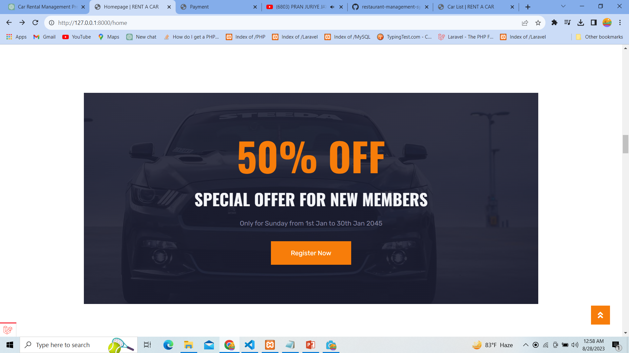

Slide 10
Vehicle details

Slide 11
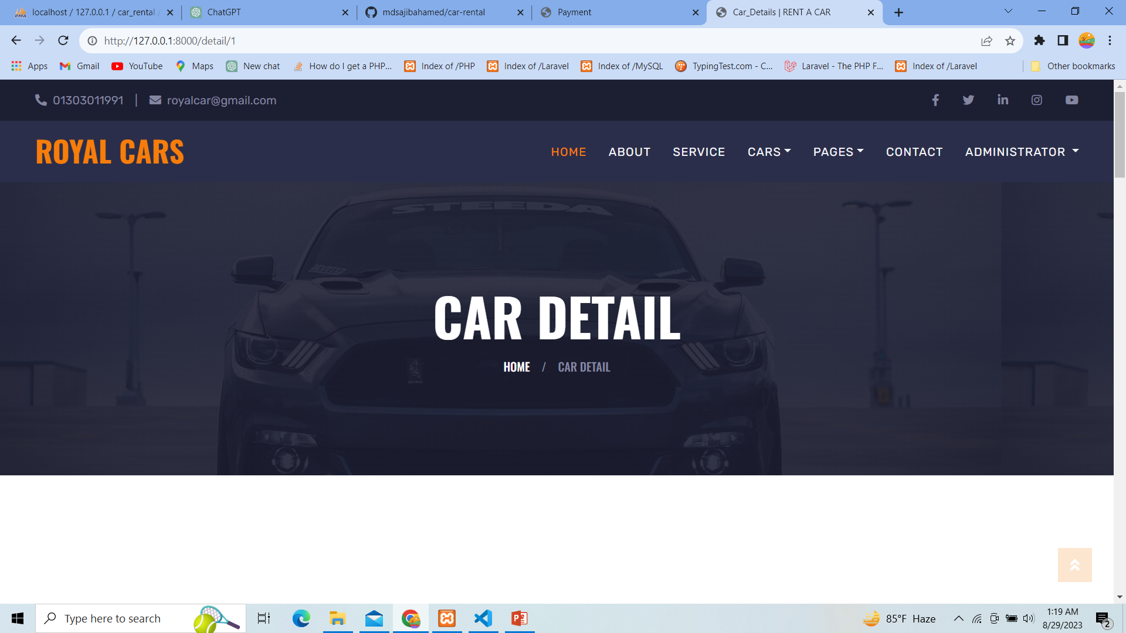

Slide 12
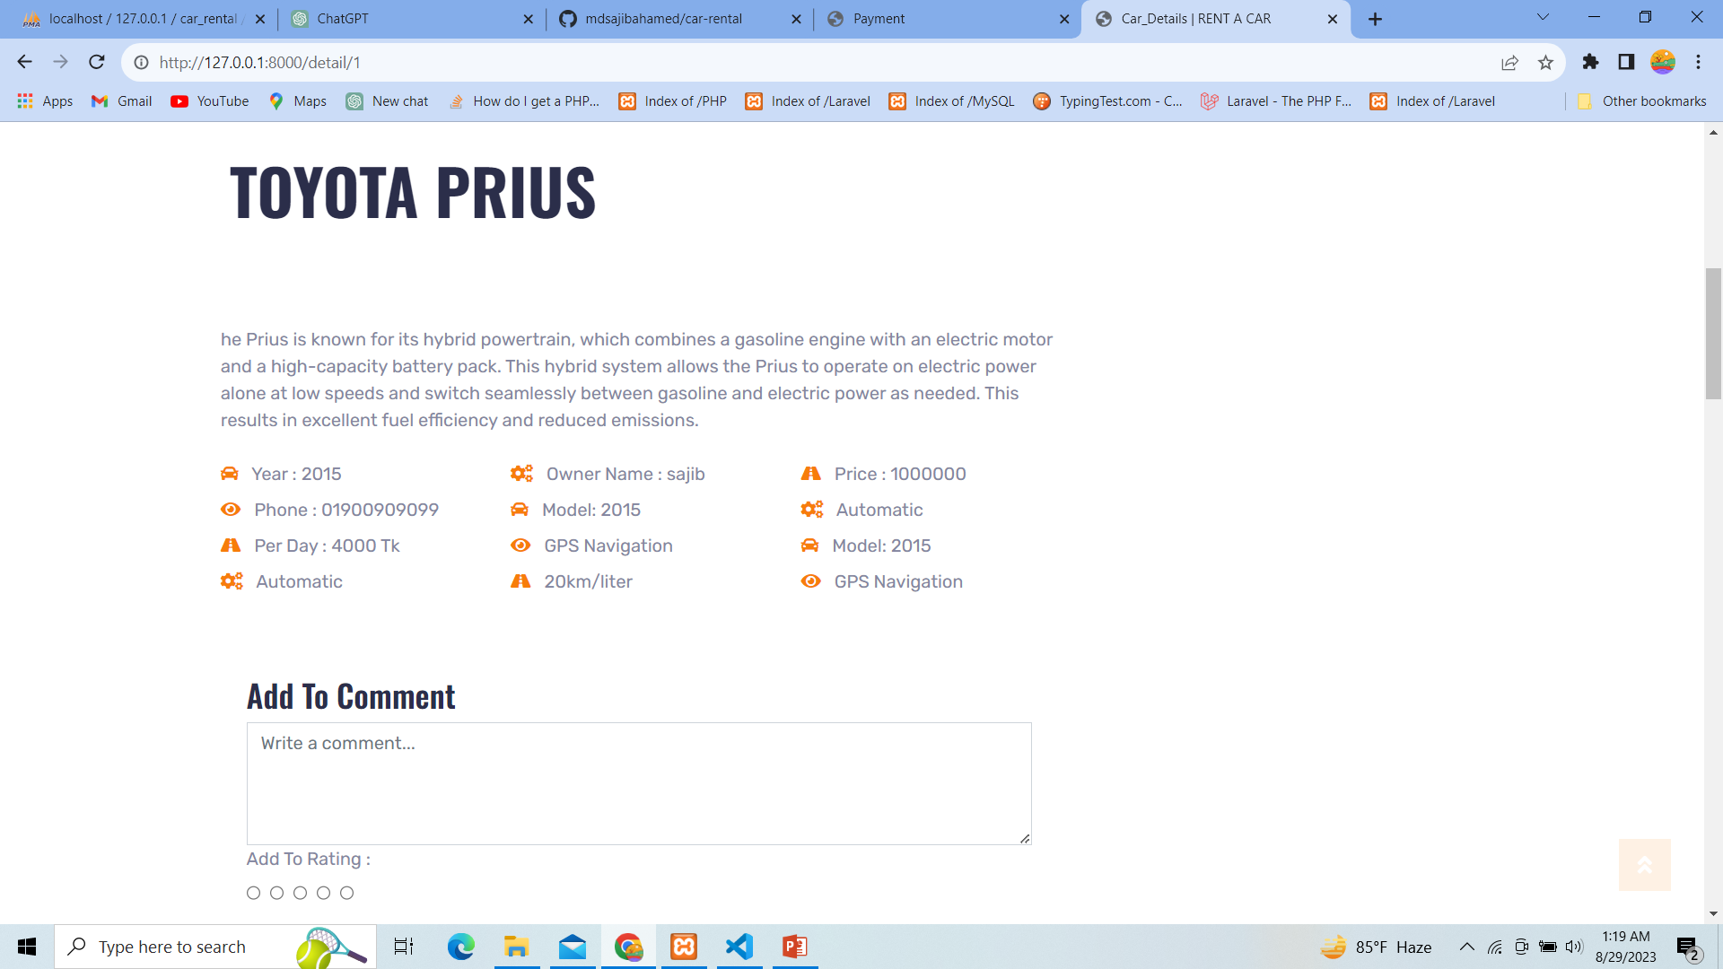

Slide 13
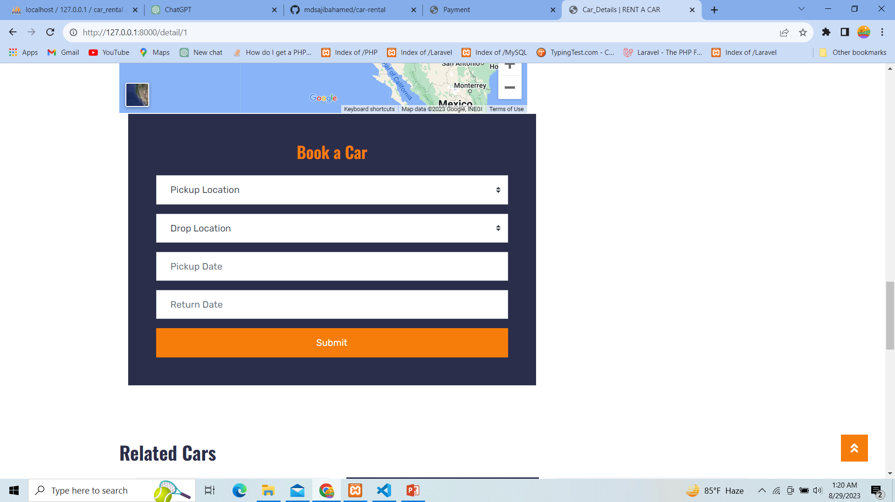

Slide 14
Services

Slide 15
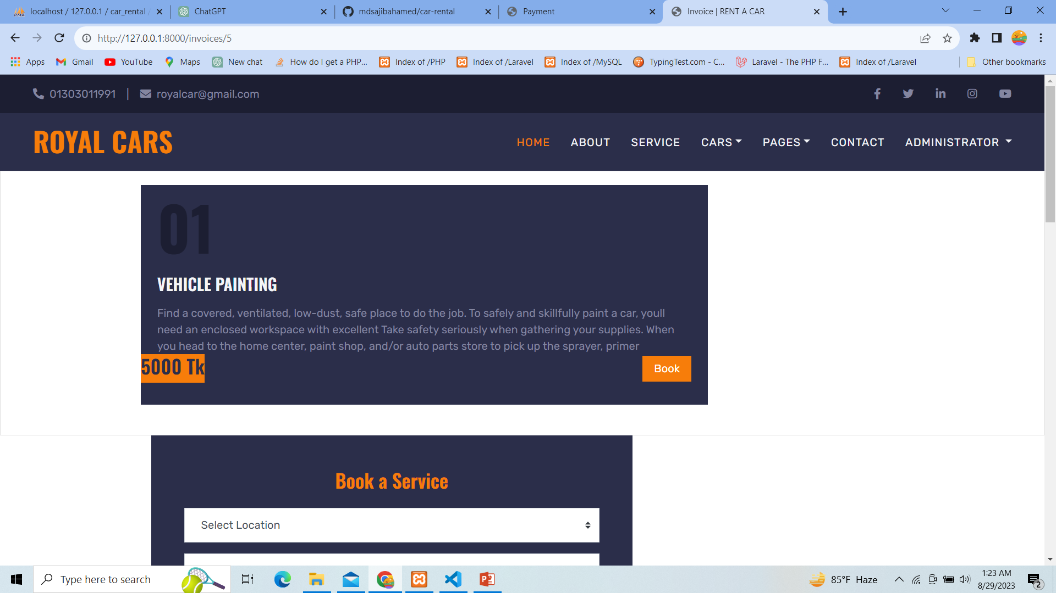

Slide 16
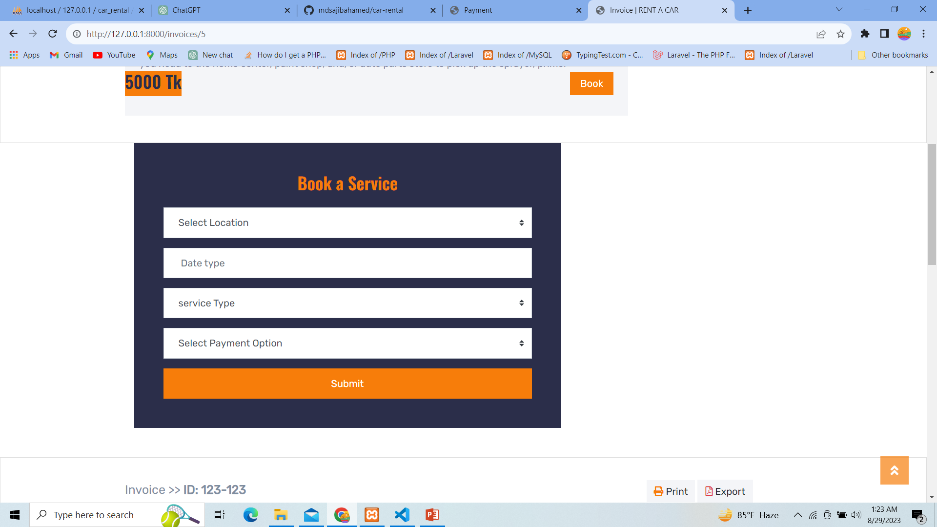

Slide 17
Car Rental Authorization or Service provider contract Information

Slide 18
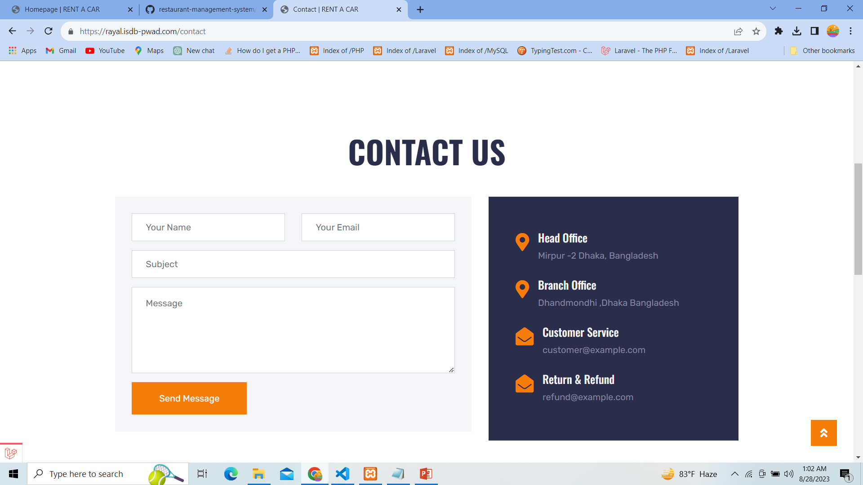

Slide 19
Admin panel dashboard dashboard : https://rayal.isdb-pwad.com/admin User role User Vehicle type Vehicle brand Vehicle add /vehicle list Rent request Service request Payment list

Slide 20
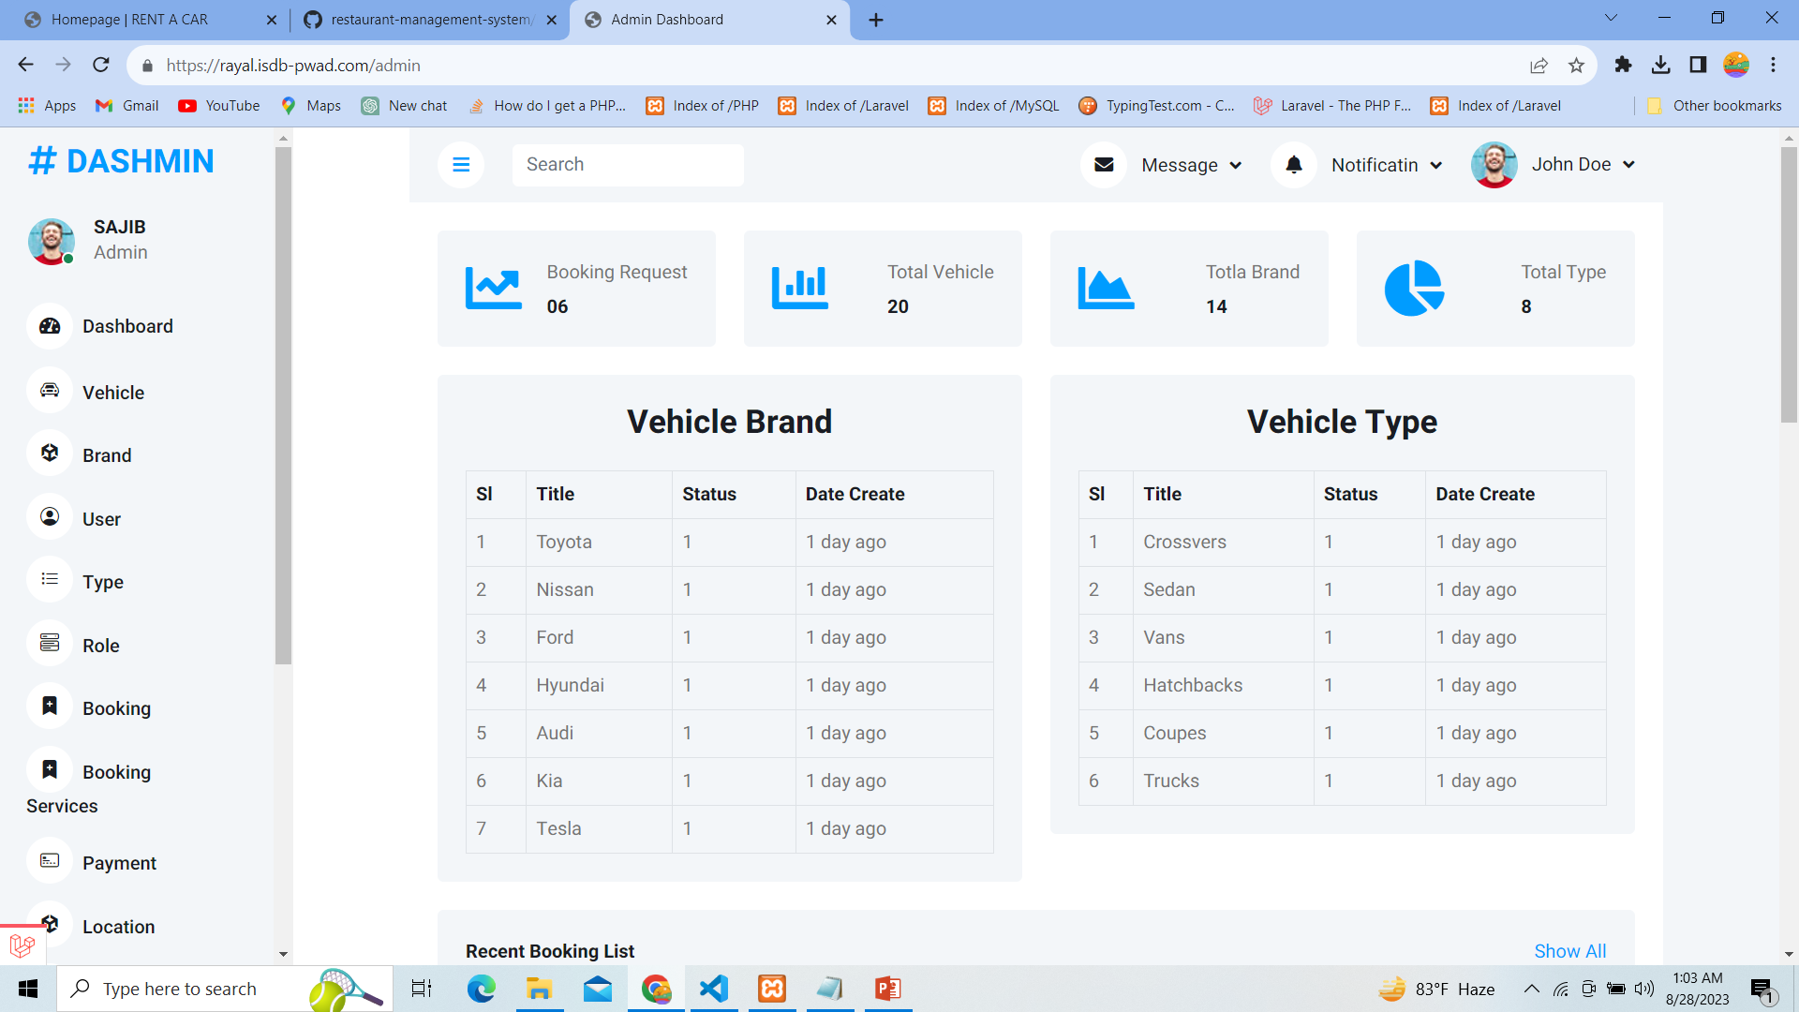

Slide 21
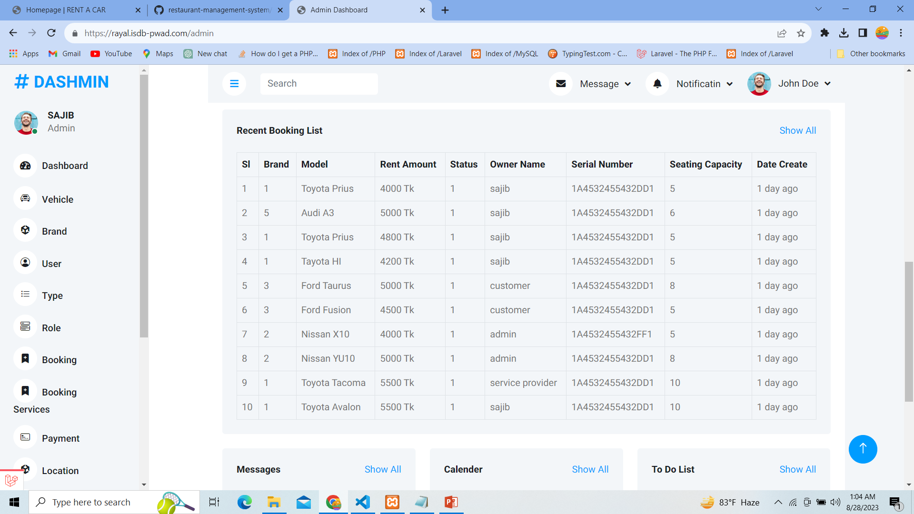

Slide 22
Vehicle booking request all Vehicle add Vehicle list Vehicle edit Vehicle delete vehicle show

Slide 23
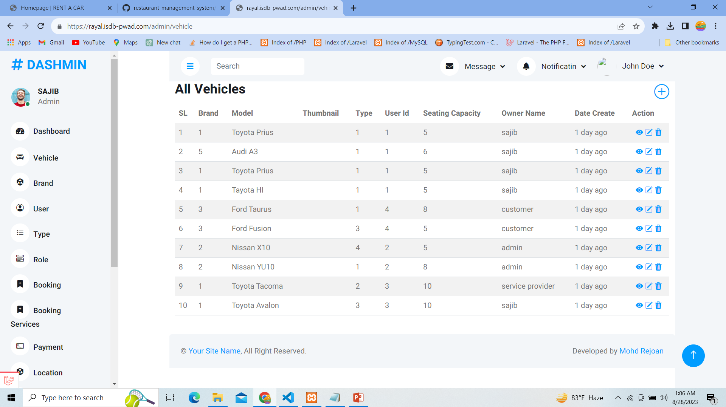

Slide 24
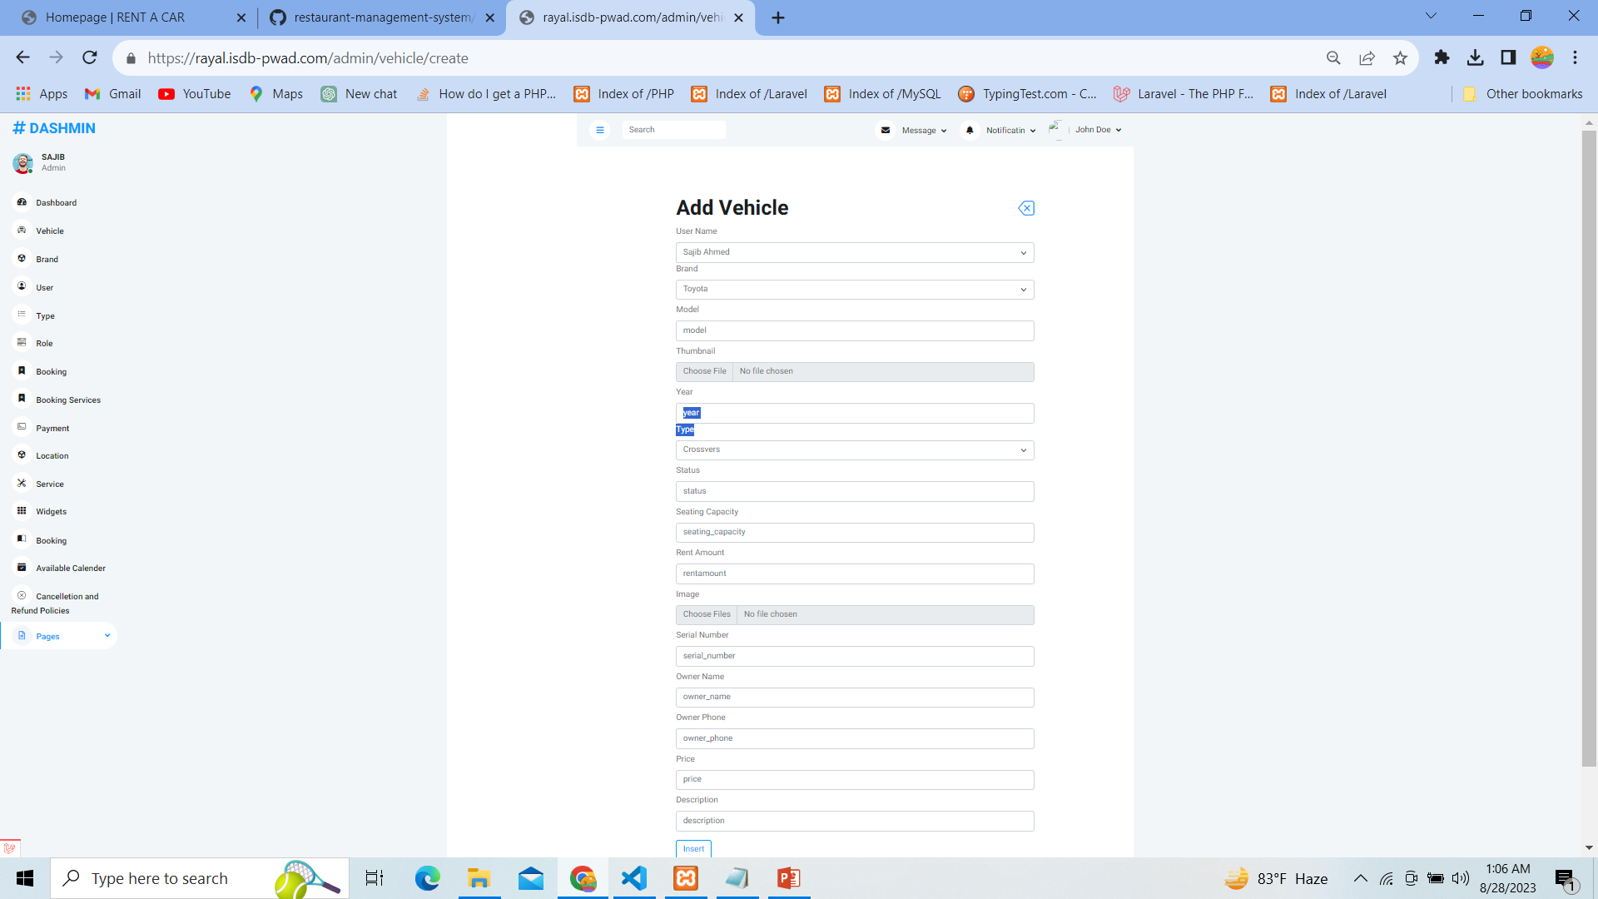

Slide 25
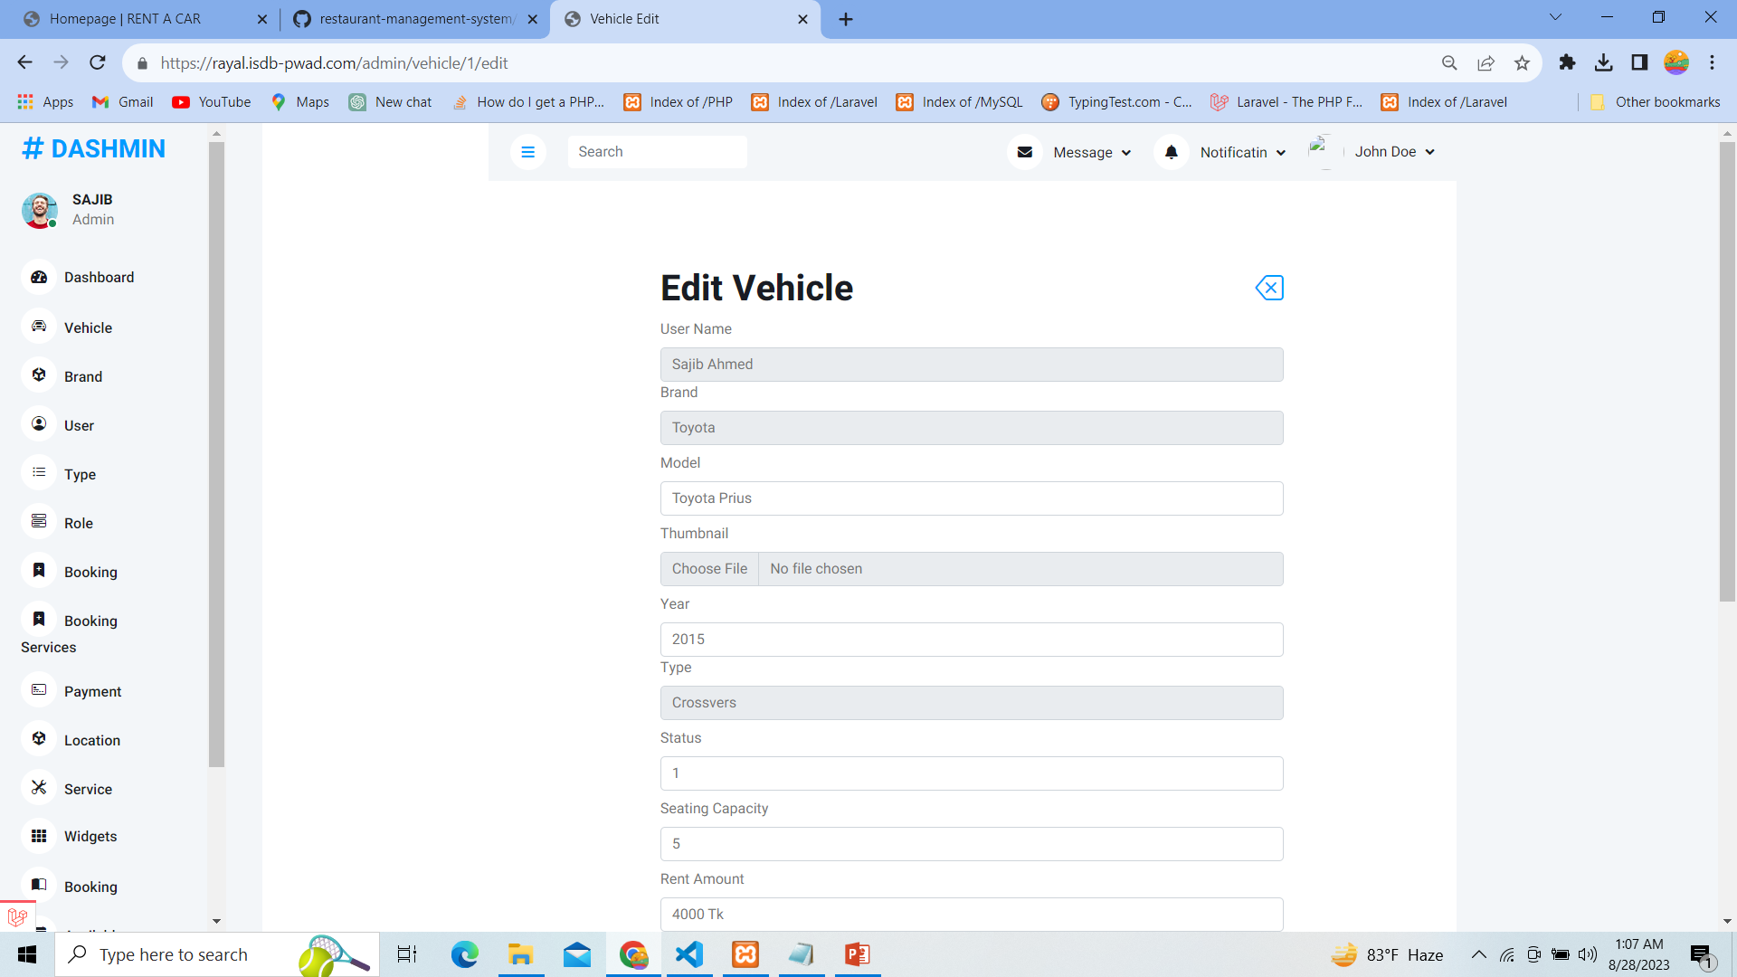

Slide 26
Vehicle Brand Add to brand Edit brand Show Brand Delete Brand

Slide 27
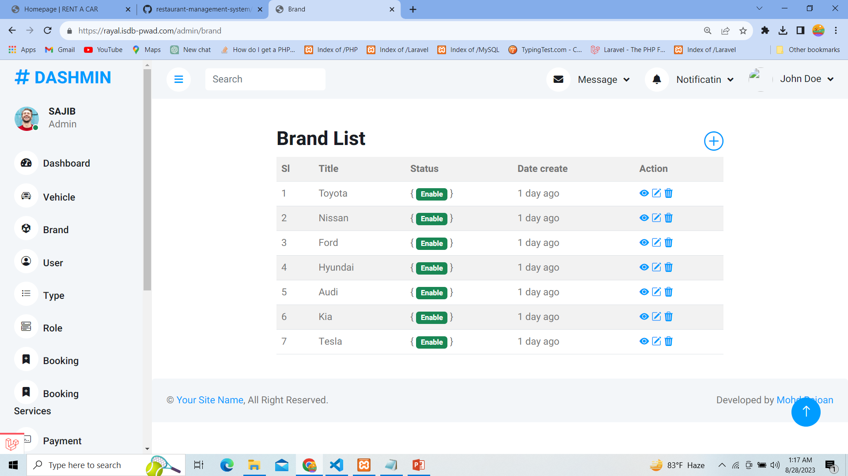

Slide 28
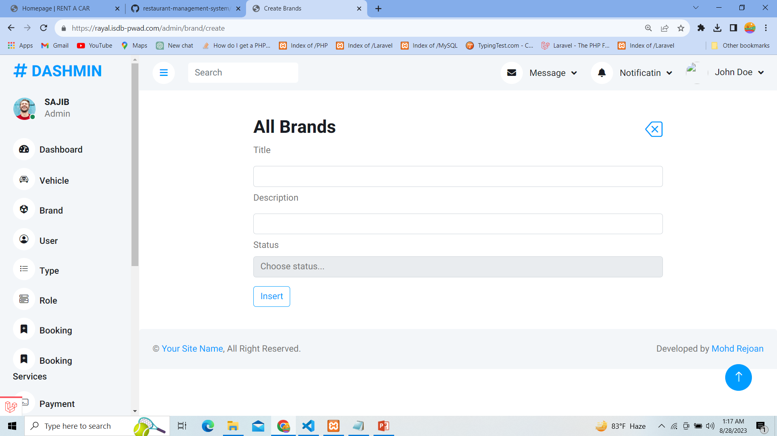

Slide 29
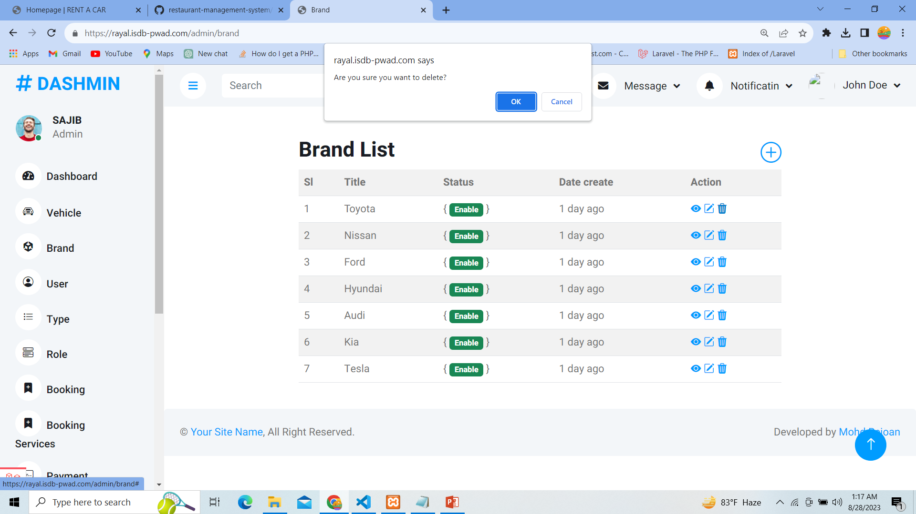

Slide 30
Booking services

Slide 31
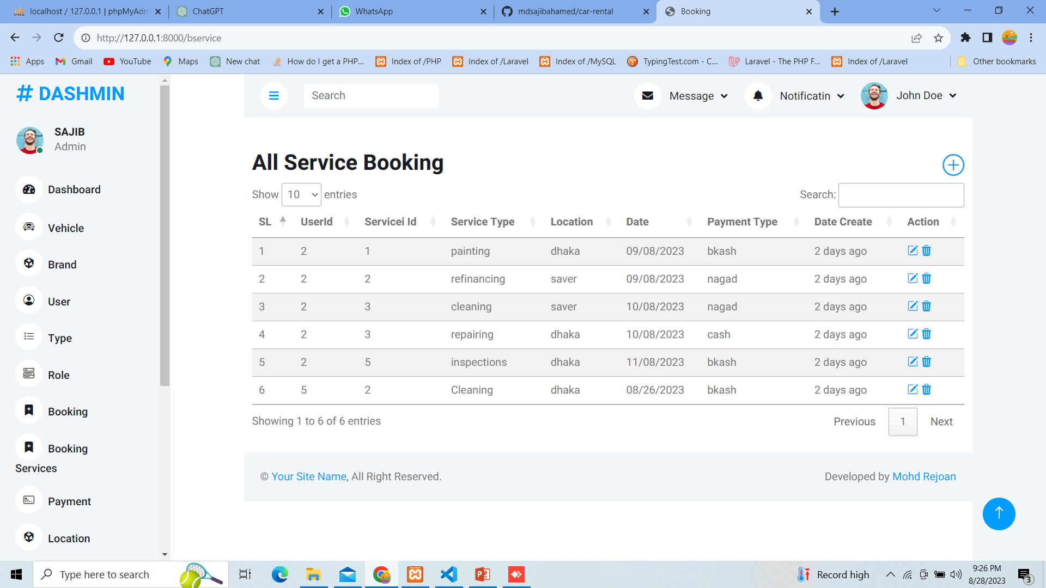

Slide 32
Payment

Slide 33
